Slide 1
Identifying climate-mediated changes in Atlantic cod spatial dynamics using VAST
Katie Lankowicz
AFS National Meeting 2023

Slide 2
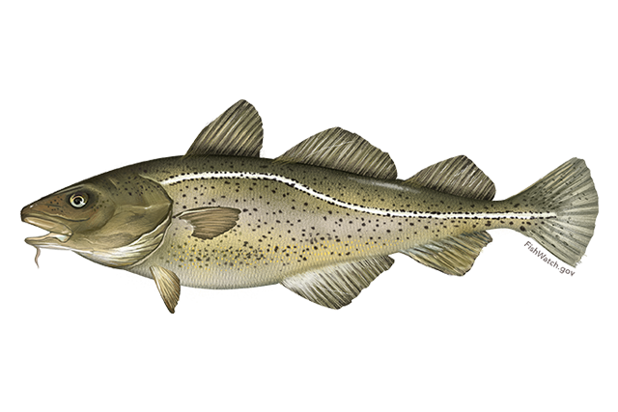
Atlantic Cod
Economically, ecologically, and culturally important species within New England’s groundfish fishery
Spatial distribution shaped by multiple habitat and oceanographic variables

Slide 3
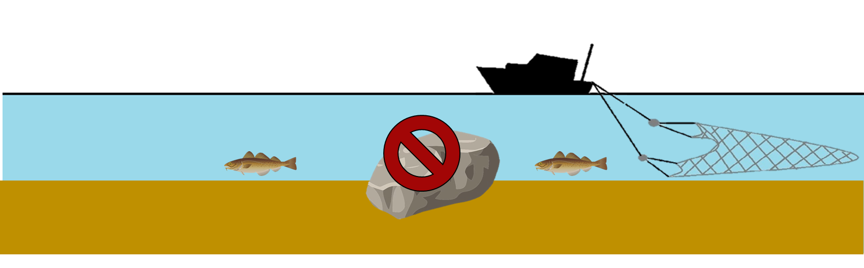
Cod assessments and habitat use
Several life history phases often found in higher densities over complex bottom habitat
Assessment and management efforts mainly informed by bottom trawl surveys

Slide 4

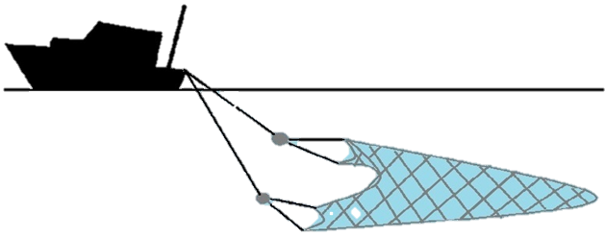
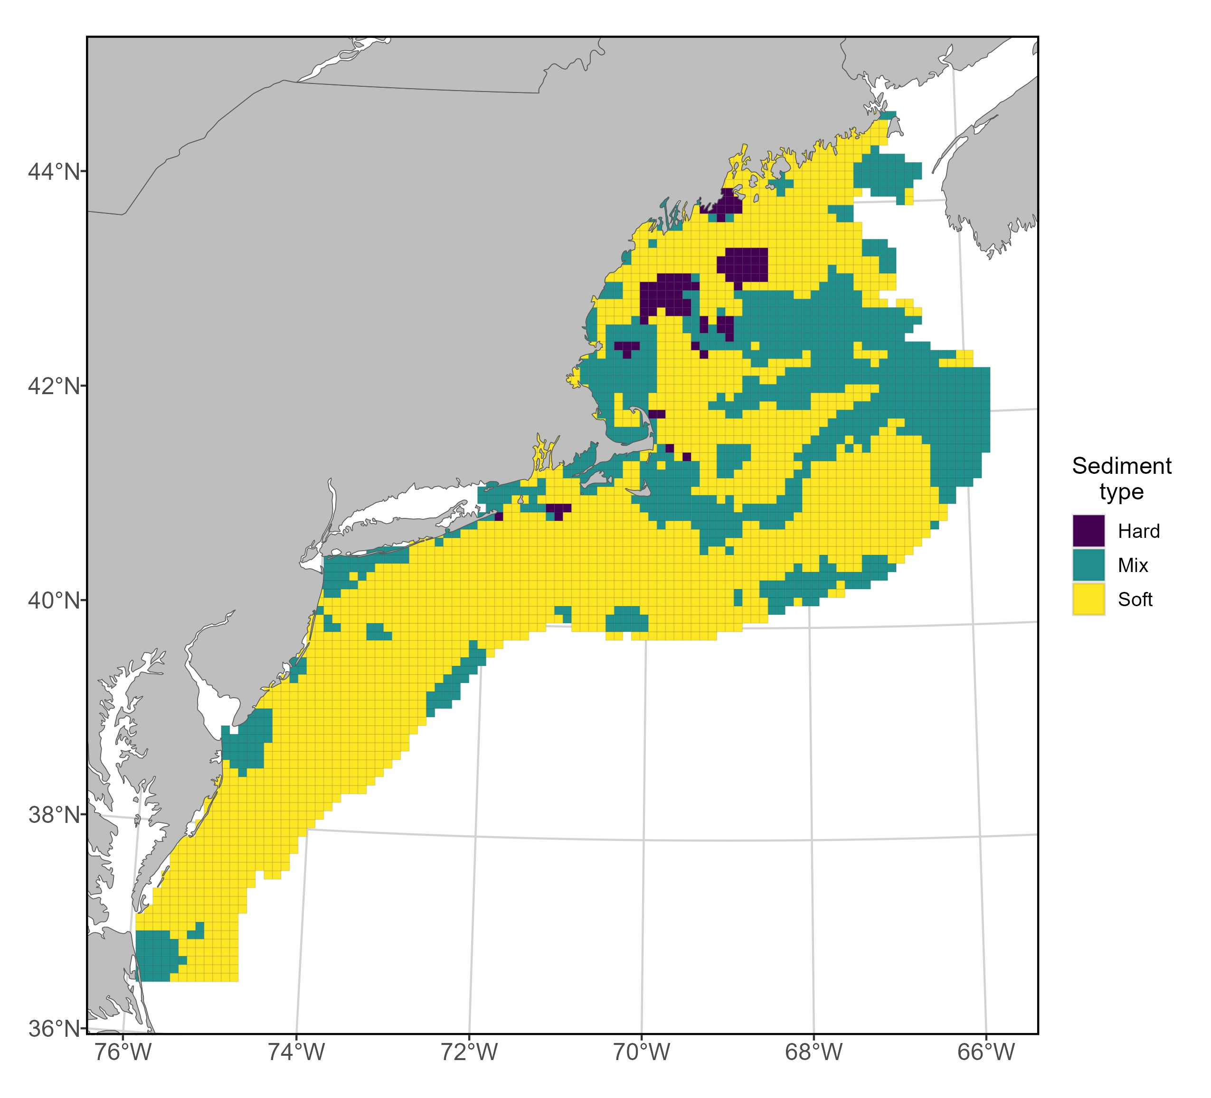

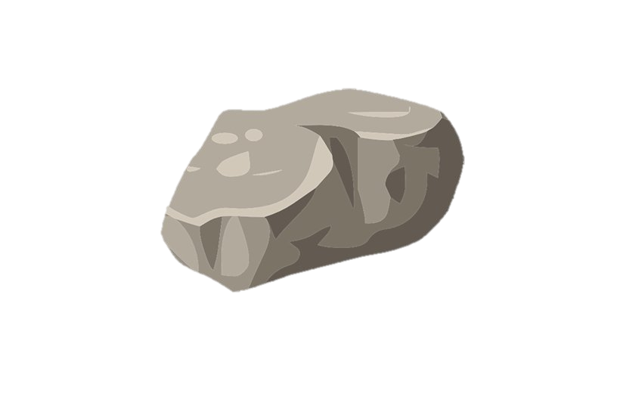

How do we fix this?
How do we fix this?

Slide 5
Approach
Vector Autoregressive Spatio-Temporal Model (VAST)
Designed to estimate spatial variation in density of one or more categories in one or more time steps.
Notes:
Objectives: map spatial density, generate indices of abundance, identify habitat associations, identify shifts in spatial dynamics

Slide 6
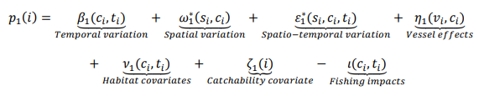
Model structure
Predictor 1: Model encounter probability at every spatial location and time step for each category
Predictor 2: Model positive catch rate (abundance) at every spatial location and time step for each category, based on the calculated encounter probability
Notes:
Spatial delta-generalized linear mixed model for multiple categories

Slide 7
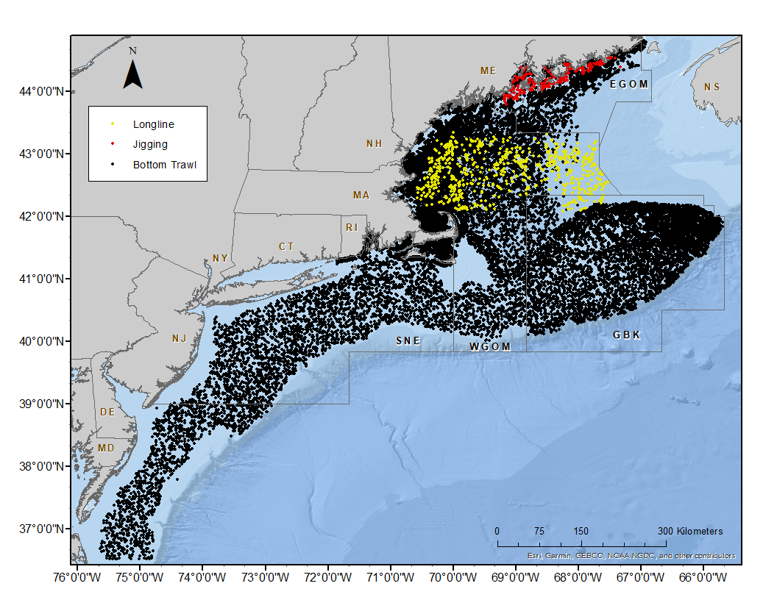
Surveys
11 surveys
Multiple gear types
40 years
(1982 – 2022)
Number and size information of cod caught at each sampling location
Area-swept effort information for all but jigging survey
Notes:
Dropped jigging survey, sensitivity analysis provided evidence that it wasn’t contributing much to model fit anyway.

Slide 8


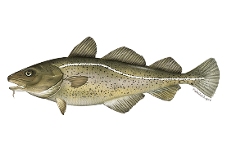
Model setup
Time steps
Size classes
1982 - 2022
March-August
September-February
Small
(< 40cm)
Medium
(40-70 cm)
Large
(>70 cm)

Slide 9
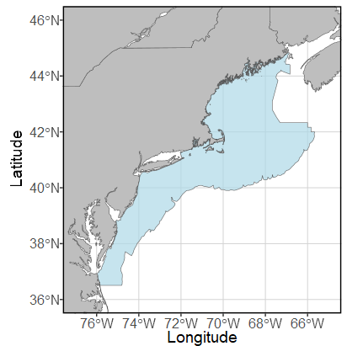
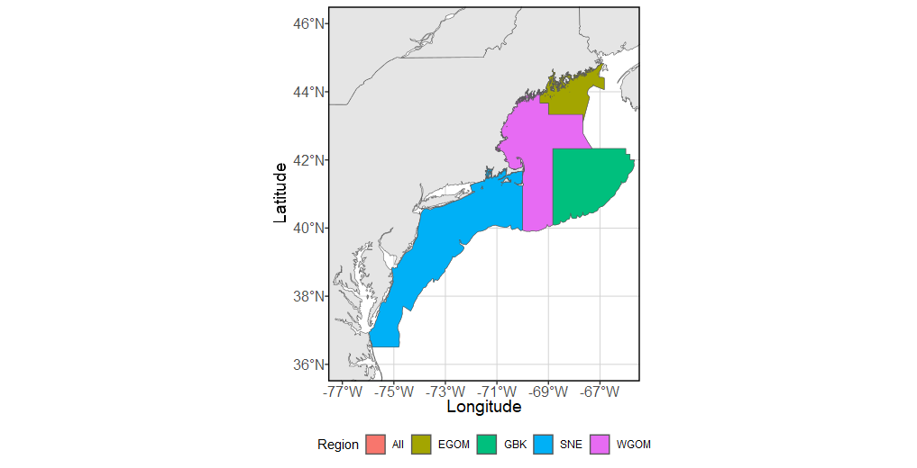
Spatial domain
Northeast US continental shelf
5 strata: Eastern Gulf of Maine, Western Gulf of Maine, Georges Bank, Southern New England, and entire area
Stock area geographic boundaries reconsidered in 2021 by cod research track group
200-knot SPDE mesh
Force 2,000 grid cells: each ~25km by 25km

Slide 10
Density covariates
Tested for collinearity prior to inclusion
Probability of sediment type: sand, mud, gravel, cobble
Rugosity
Bathymetry
Daily bottom temperature
Basin-wide climate indices: daily NAO index, monthly AMO index
Cubic spline additive model for both predictors
Response variable ~ cs(Density Covariate 1) + … + cs(Density Covariate n)

Slide 11
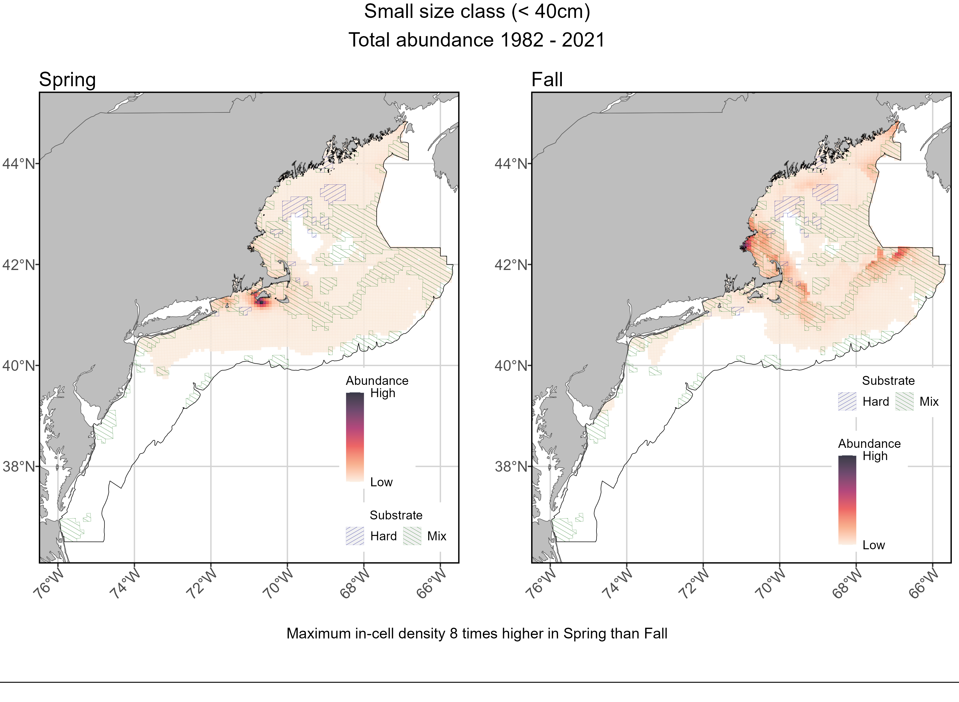
Sum of spatial density

Slide 12
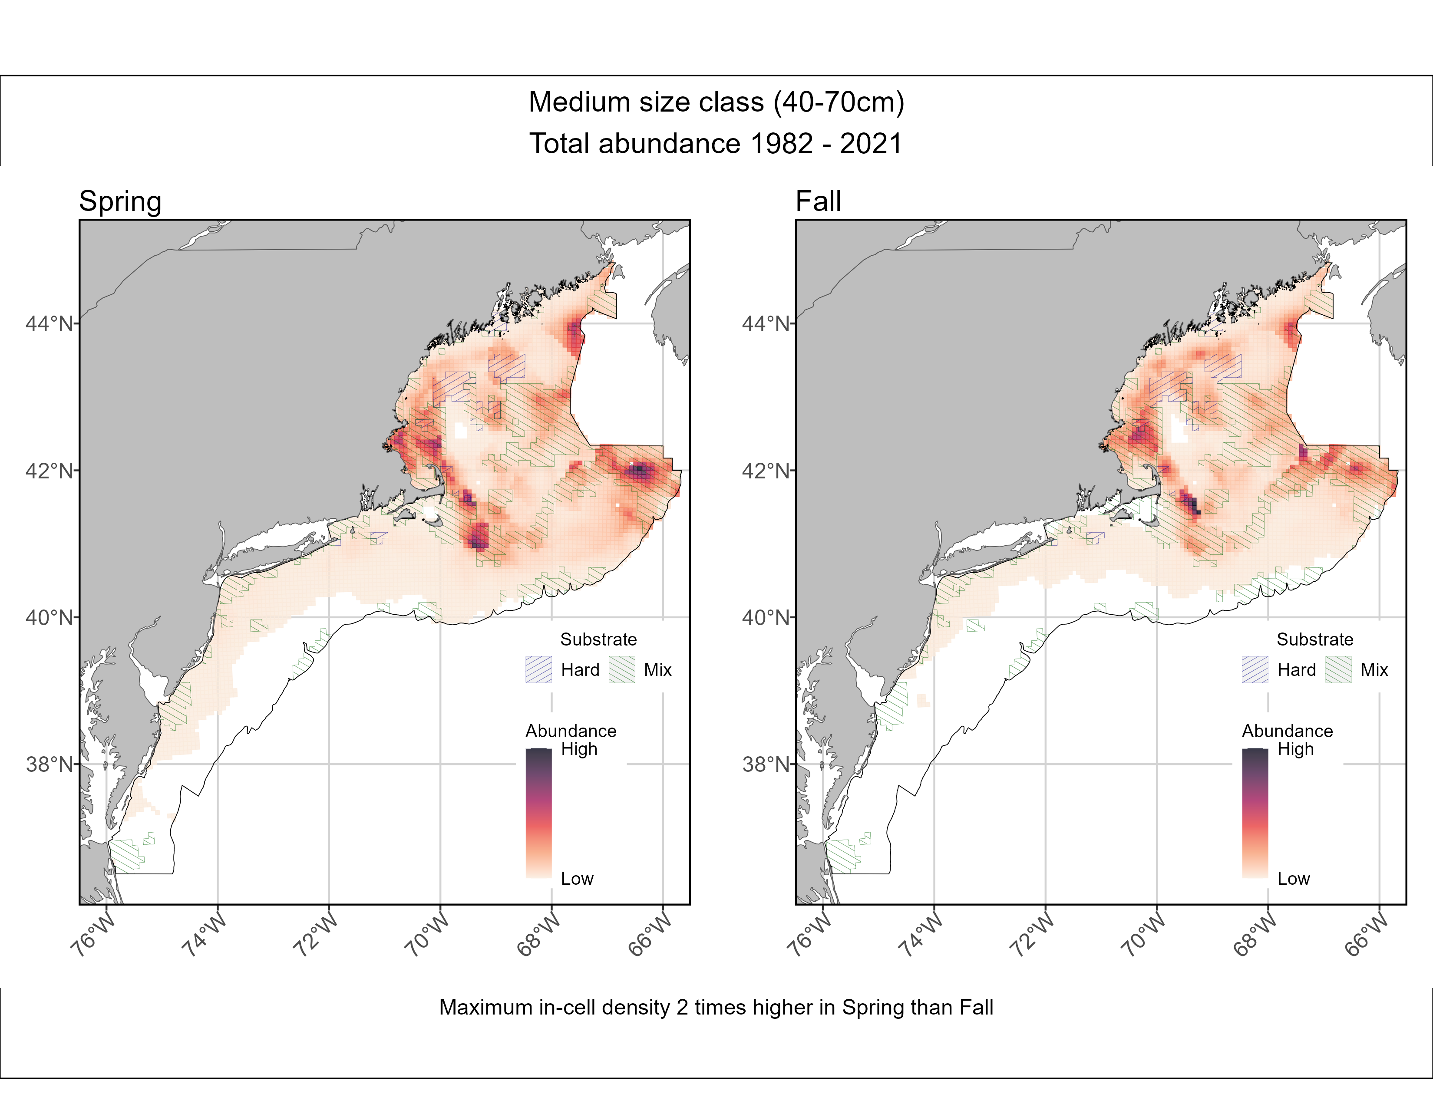
Sum of spatial density

Slide 13
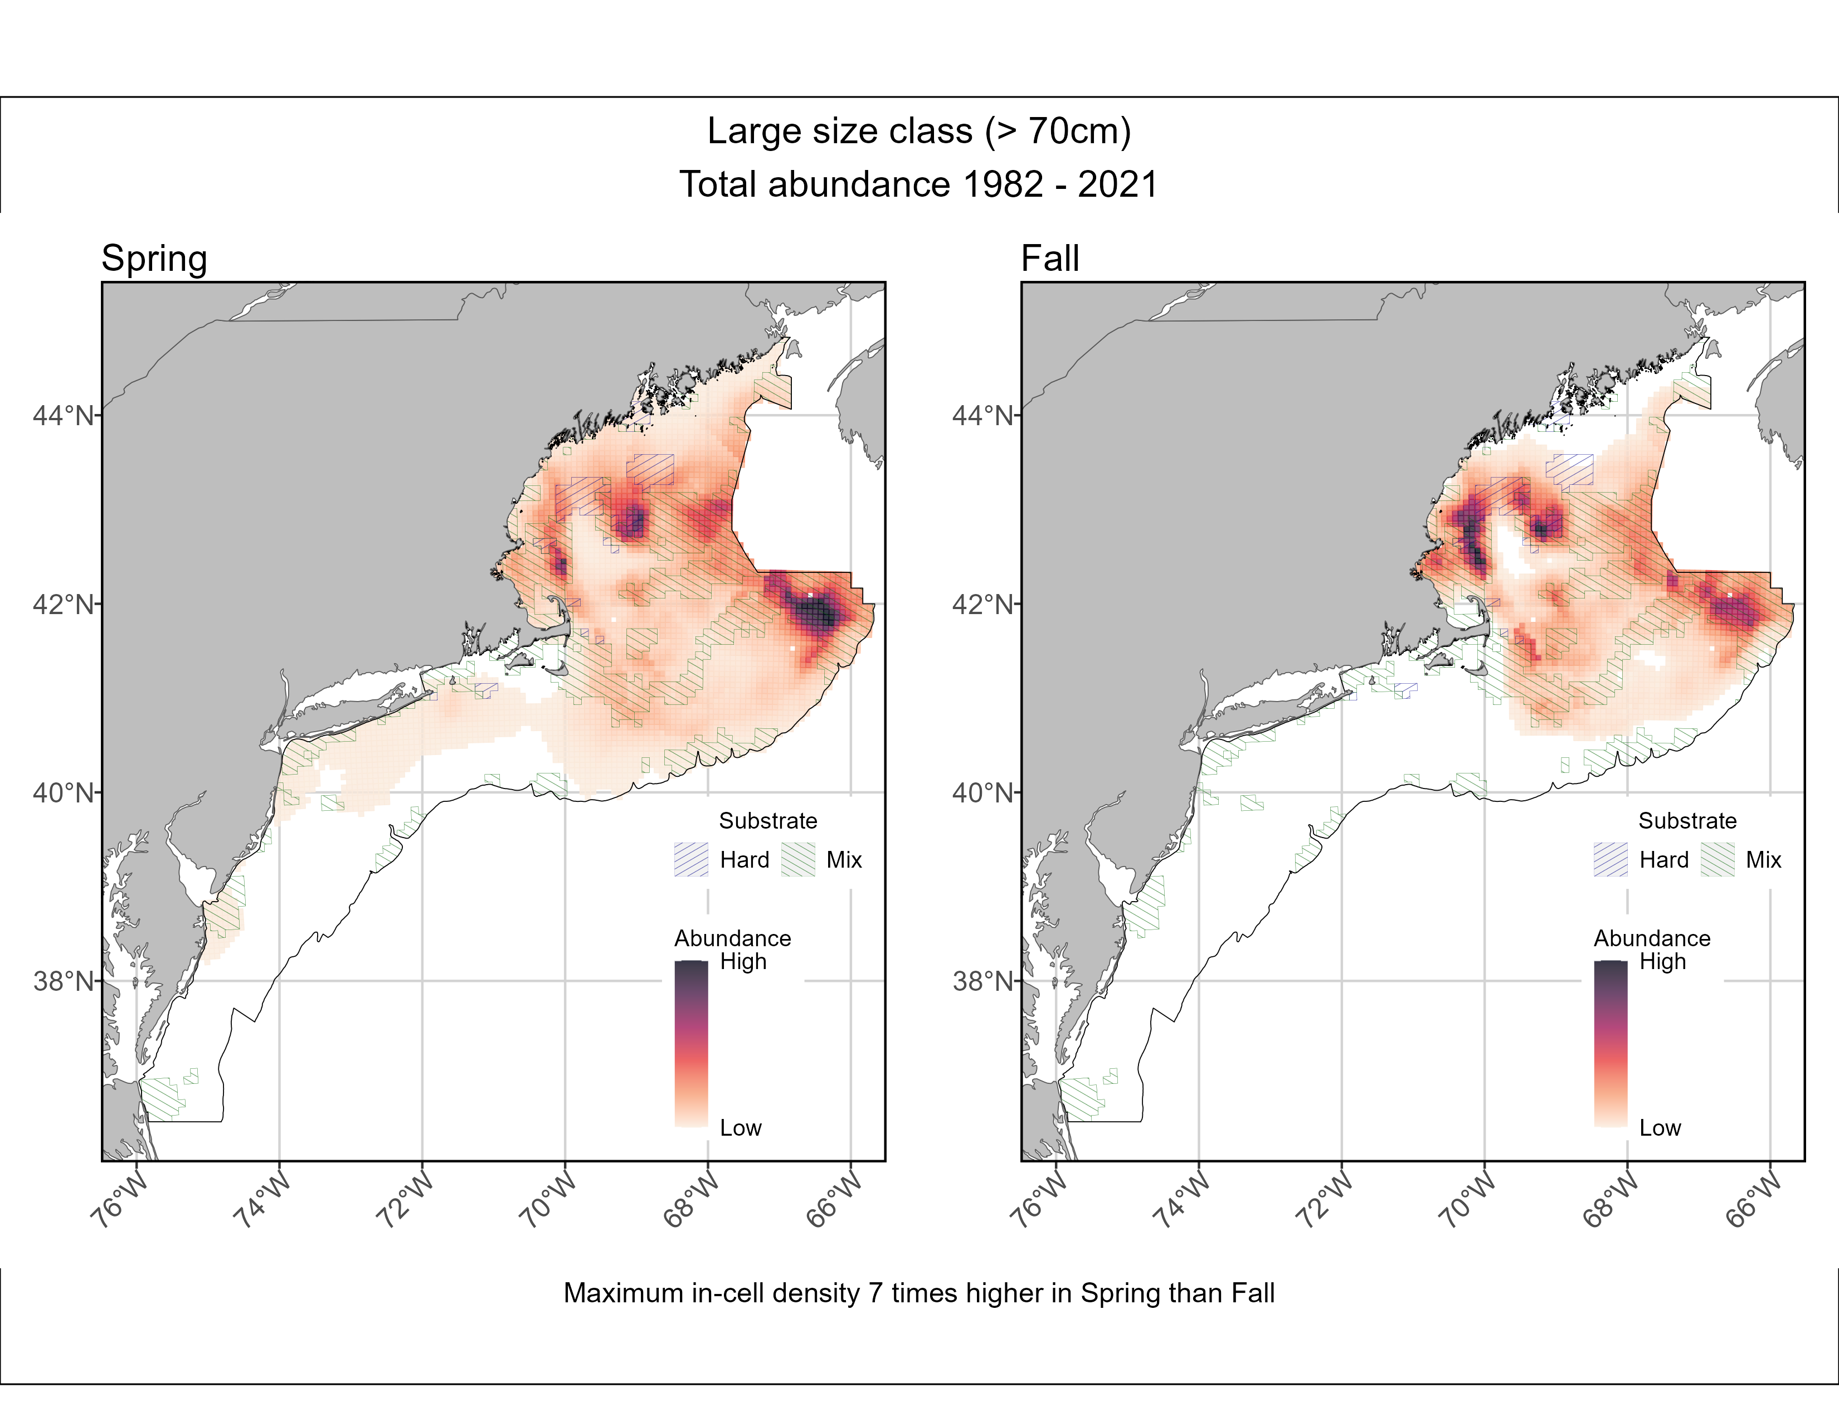
Sum of spatial density

Slide 14
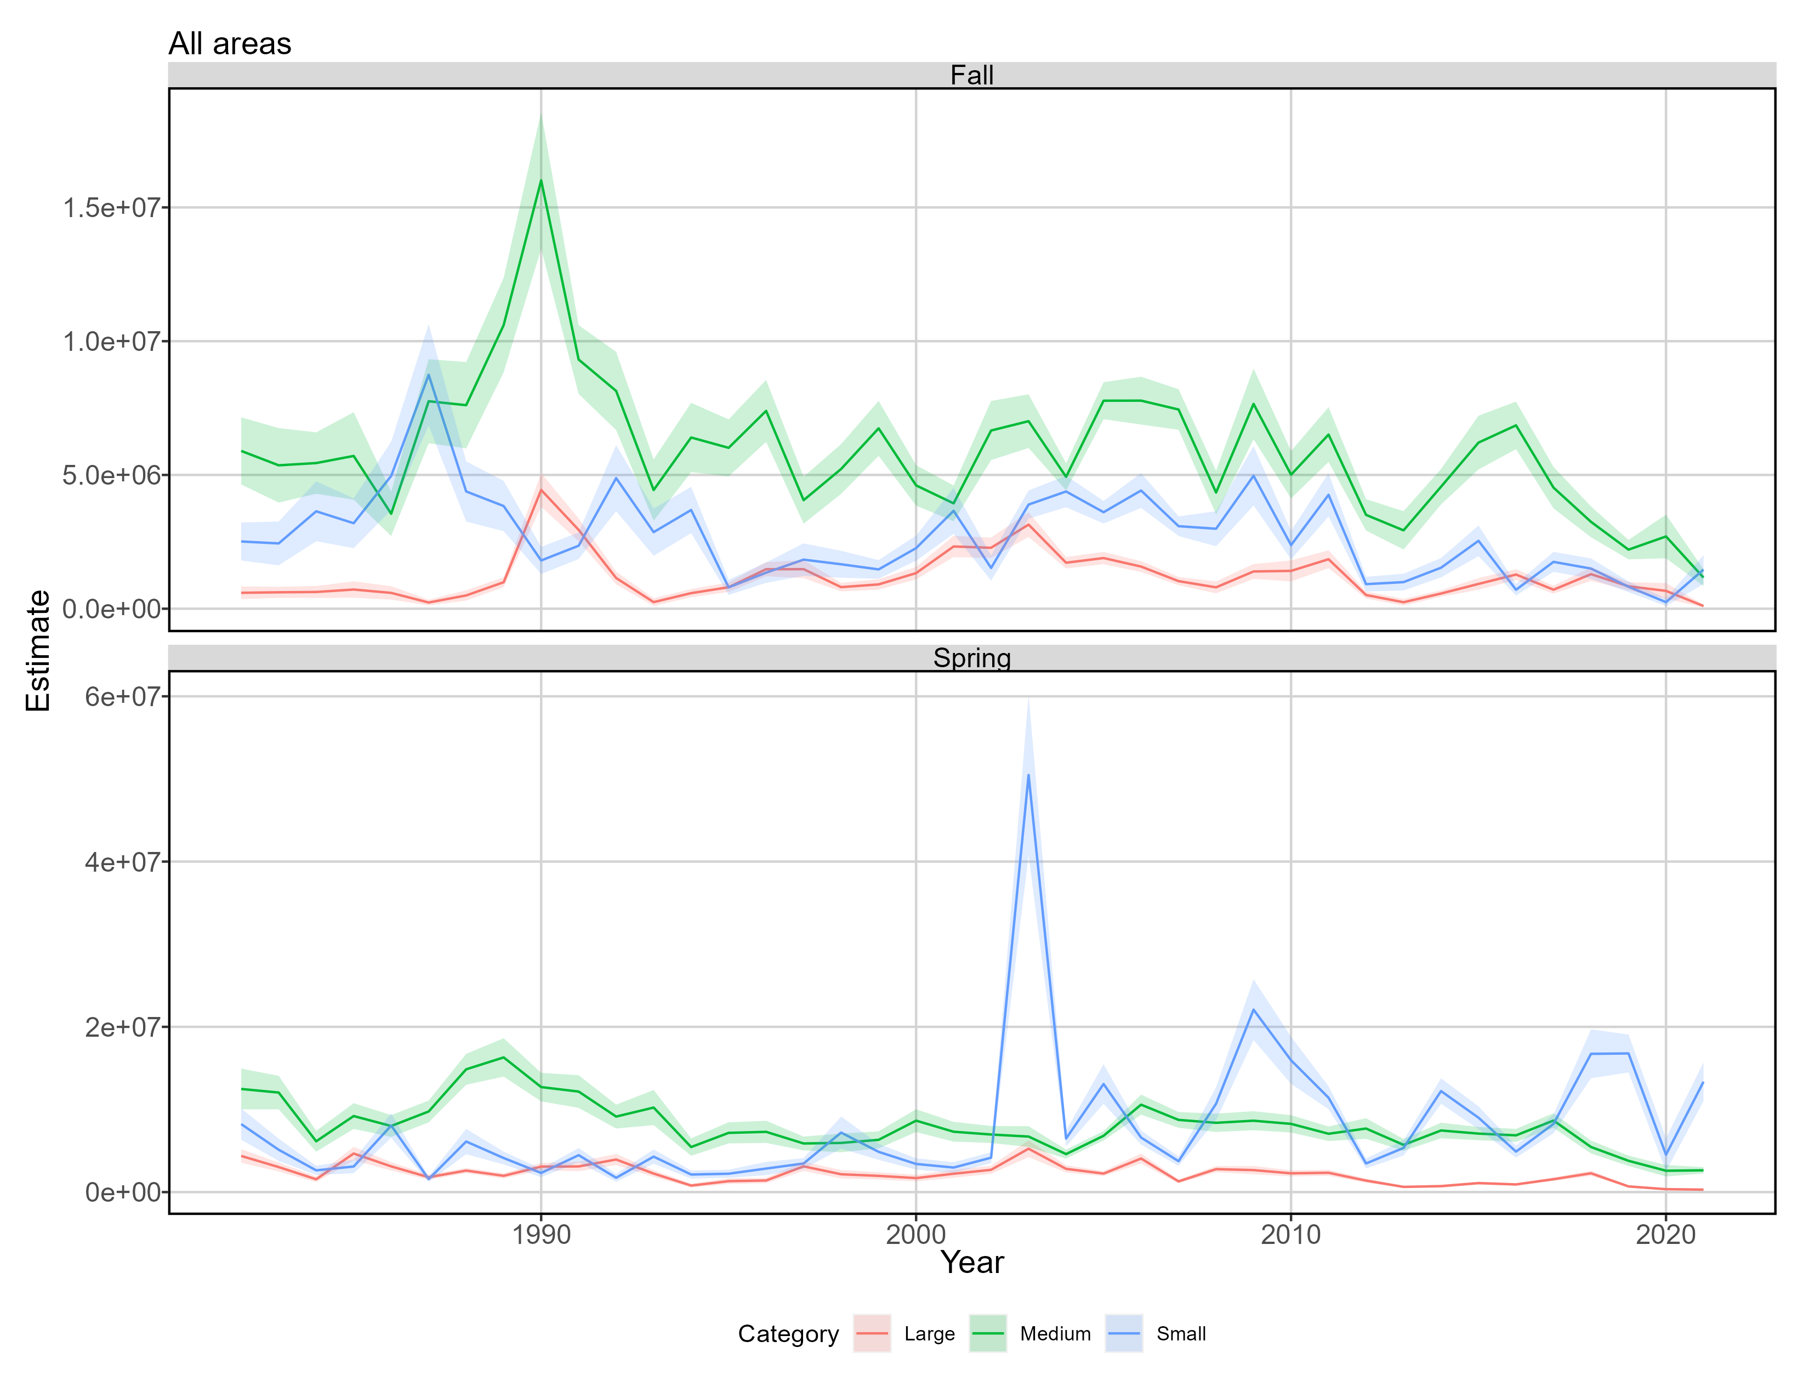
Indices of abundance

Slide 15
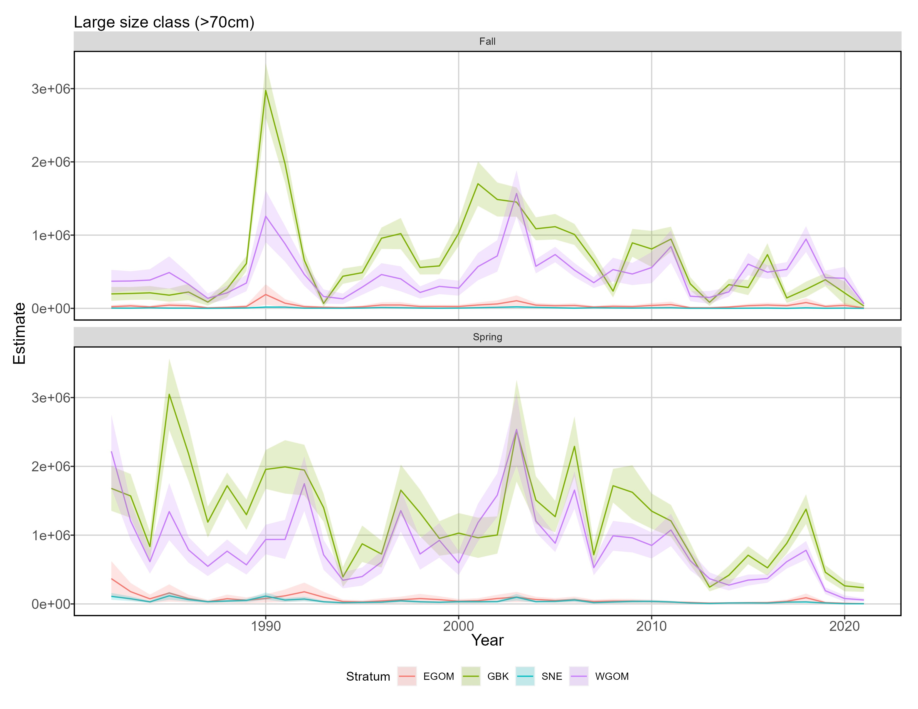
Indices of abundance

Slide 16
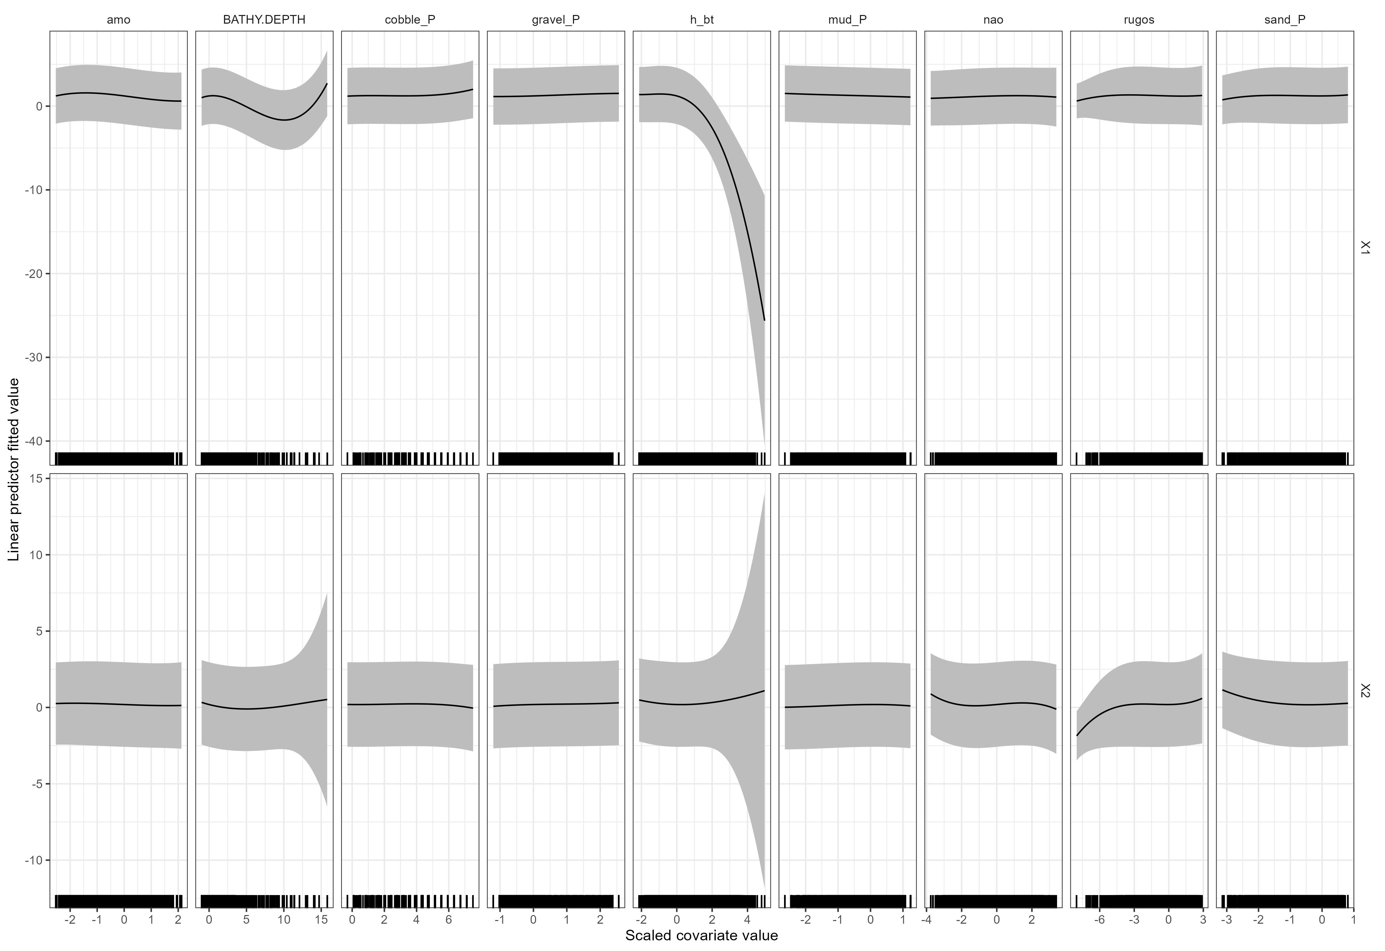
Habitat associations
Large size class, presence/absence
Bottom temp.
AMO
Depth
Cobble
Gravel
Mud
NAO
Rugosity
Sand

Slide 17
Habitat associations
Large size class, abundance
Bottom temp.
AMO
Depth
Cobble
Gravel
Mud
NAO
Rugosity
Sand

Slide 18
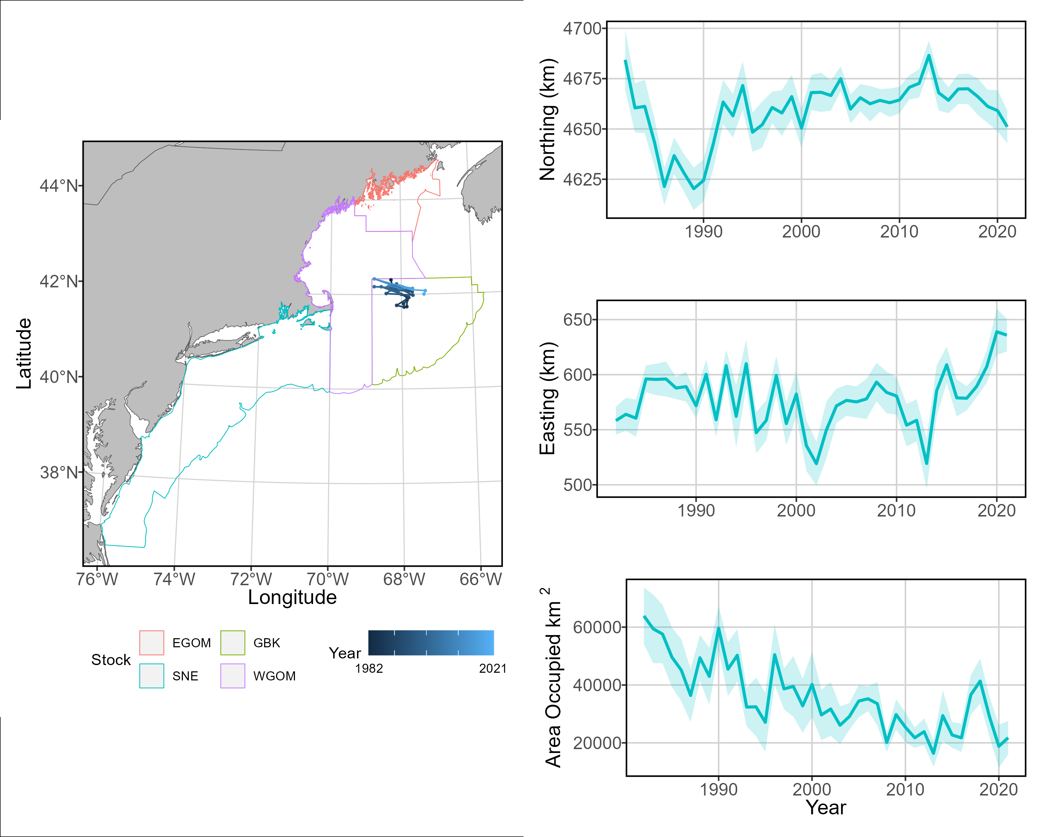
Spatial dynamics, all stock areas Large size – Spring

Slide 19
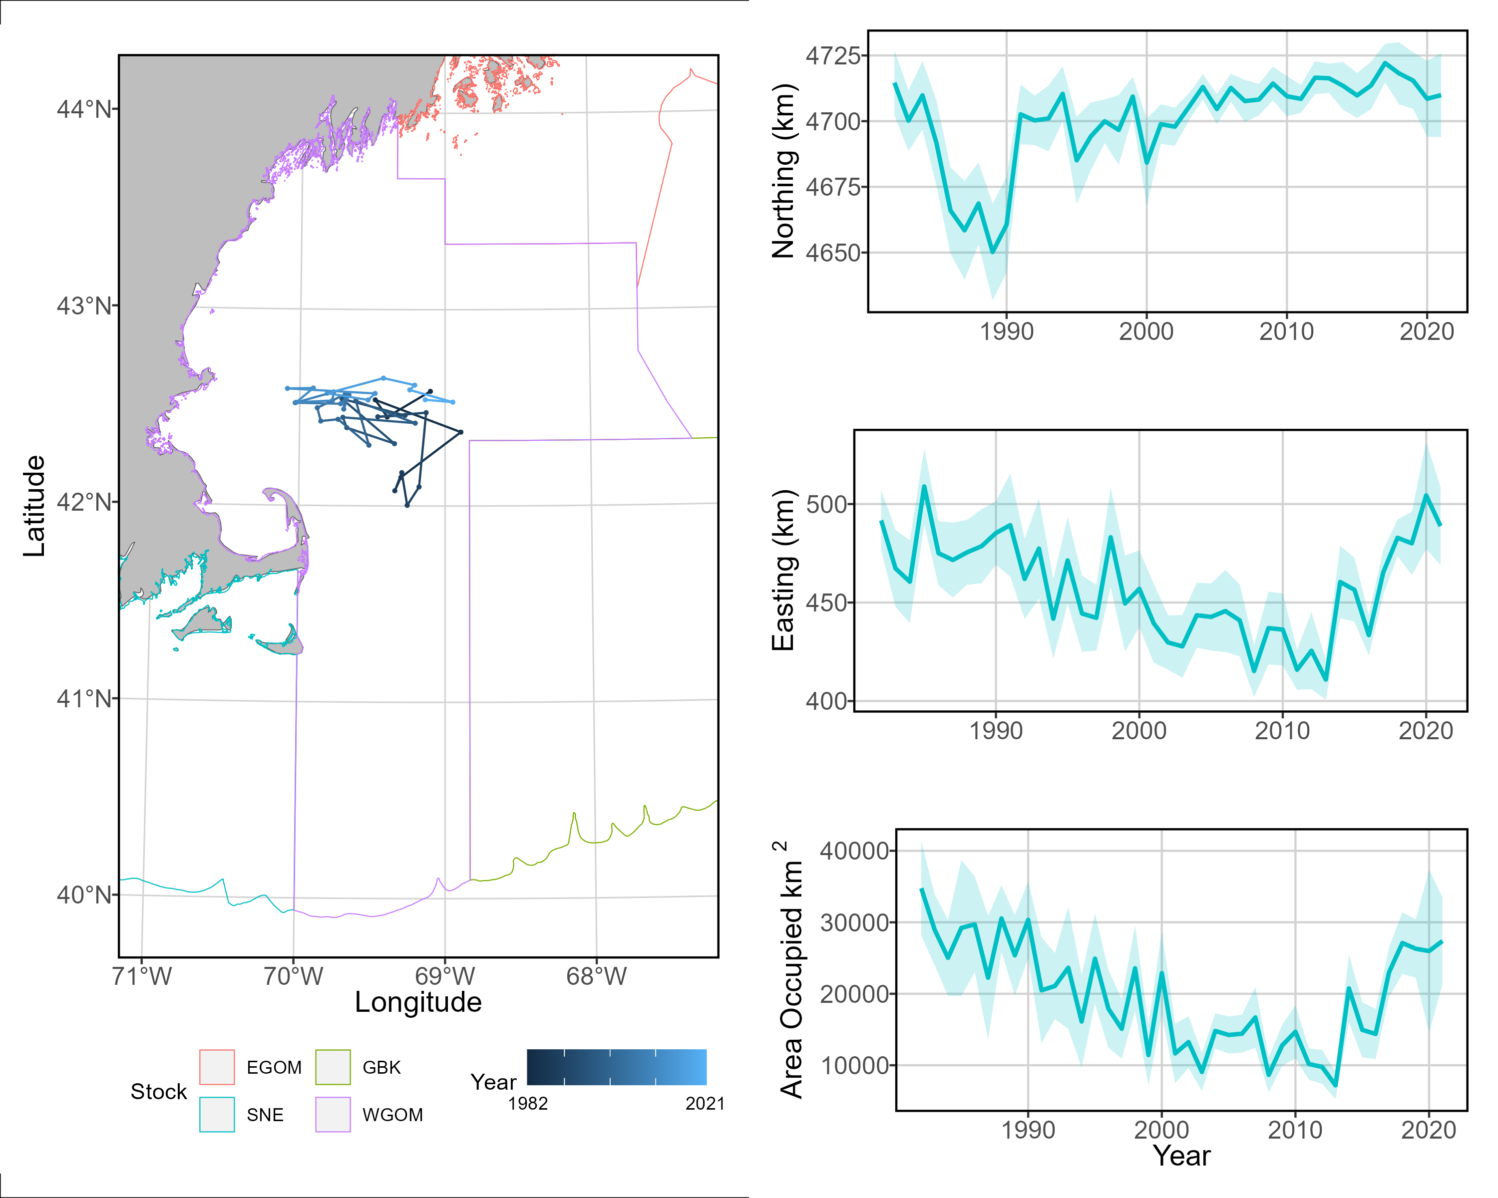
Spatial dynamics, WGOM Large size – Spring

Slide 20
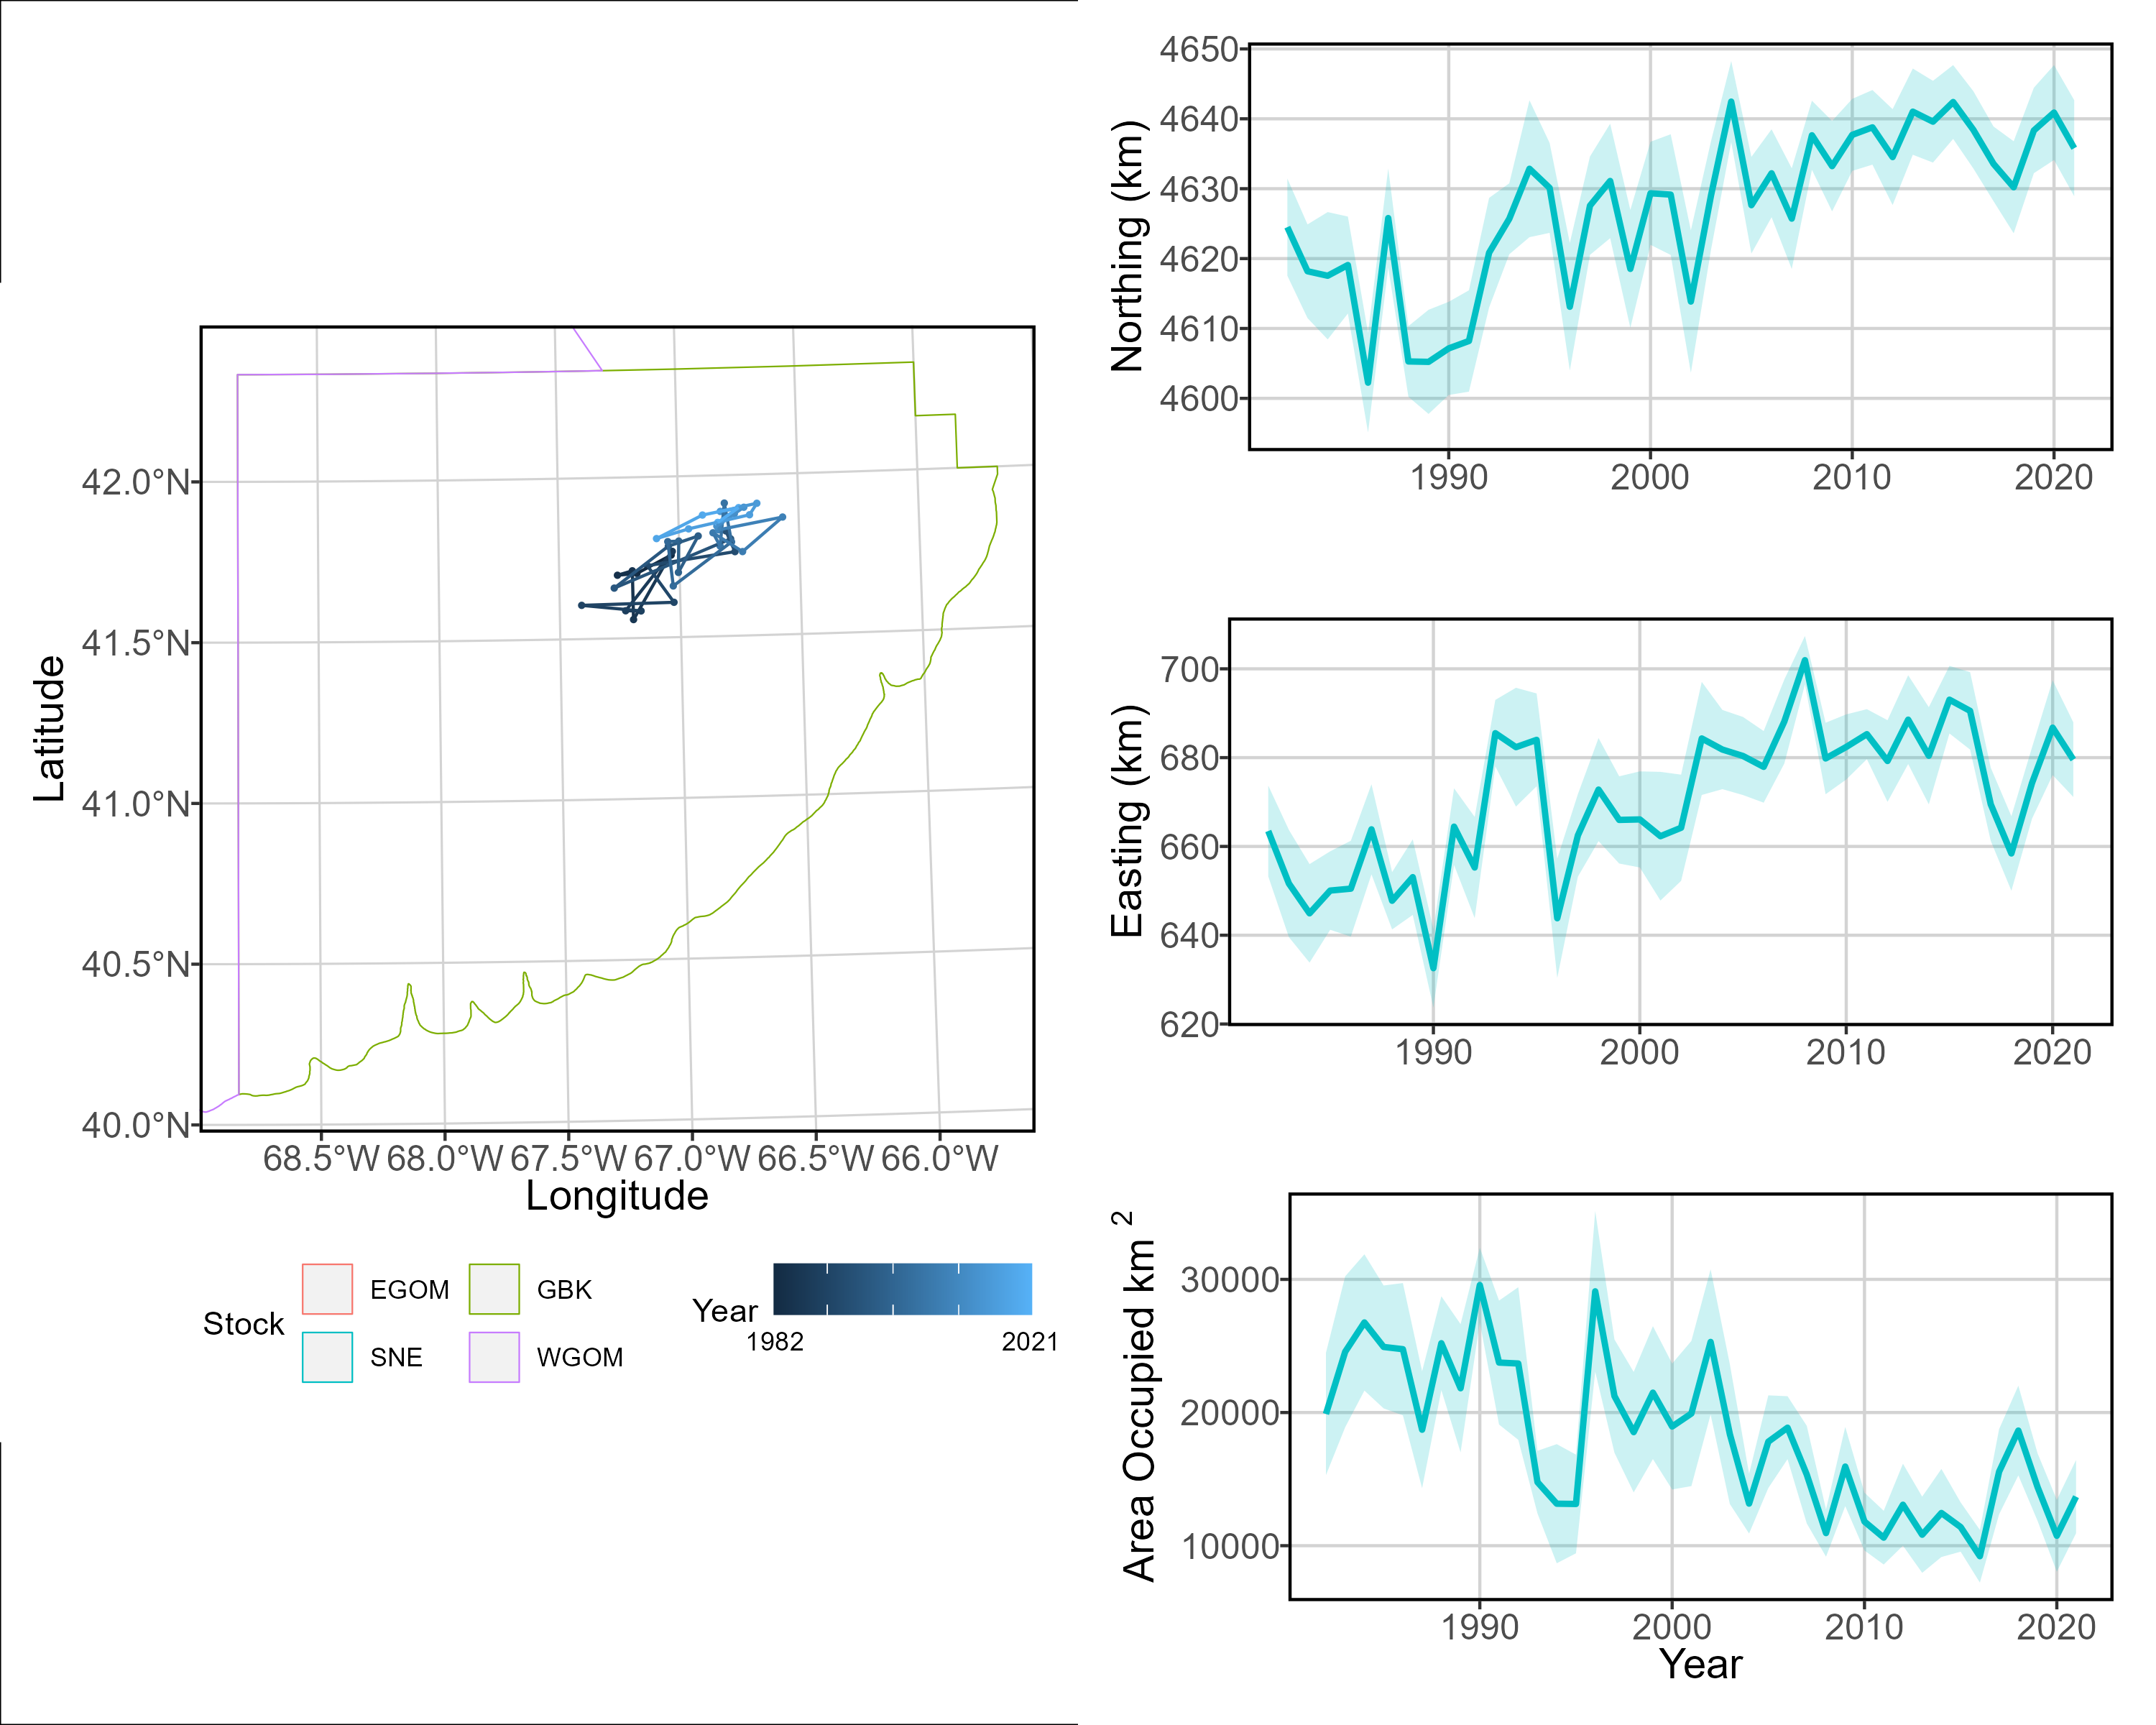
Spatial dynamics, GBK Large size – Spring

Slide 21
Conclusions
VAST is a flexible model framework
Capable of combining multitudes of data and generating spatial dynamics information pertinent to ecological and stock assessment research
Spatial density is variable across the size classes and within the stock areas
North-south and inshore-offshore gradients of abundance linked to size
Indices of abundance for all size classes generally declined over the modeled period in all stock areas
Small size class showed high variability and possible increasing trend in spring

Slide 22
Conclusions
Strength of habitat associations variable with size
Large size class presence driven by bottom temperature, abundance within areas of presence not strongly associated with any covariate tested
Small and medium size class presence driven by bottom temperature, depth, rugosity
Stock centers of gravity shifting northeast, particularly in spring
Effective area occupied trends variable with stock area, size class, and season

Slide 23
Implications
Shifting centers of gravity may be driven by changes in spatial extent of areas with preferable bottom temperature
Decline in area occupied indicates spatial area of habitat with both suitable depth and suitable bottom temperature is decreasing
Important to quantify reduction in spatial area of high-suitability habitats as warmer bottom temperatures spread northward

Slide 24

Acknowledgements
Lisa Kerr
Graham Sherwood
Jon Grabowski
Jackie Odell
Vito Giacalone
Felipe Restrepo
Brad Harris
Hubert duPontavice
Andrew Allyn
Alex Hansell
Staff and survey managers at:
DFO
NOAA NEFSC
ASMFC Northern shrimp trawl
ME-NH Inshore trawl
Eastern Gulf of Maine Sentinel survey
SMAST video trawl survey
MA DMF
URI GSO Trawl
RI DEM

Slide 25


: klankowicz@gmri.org
: @KatieLankowicz

Slide 26
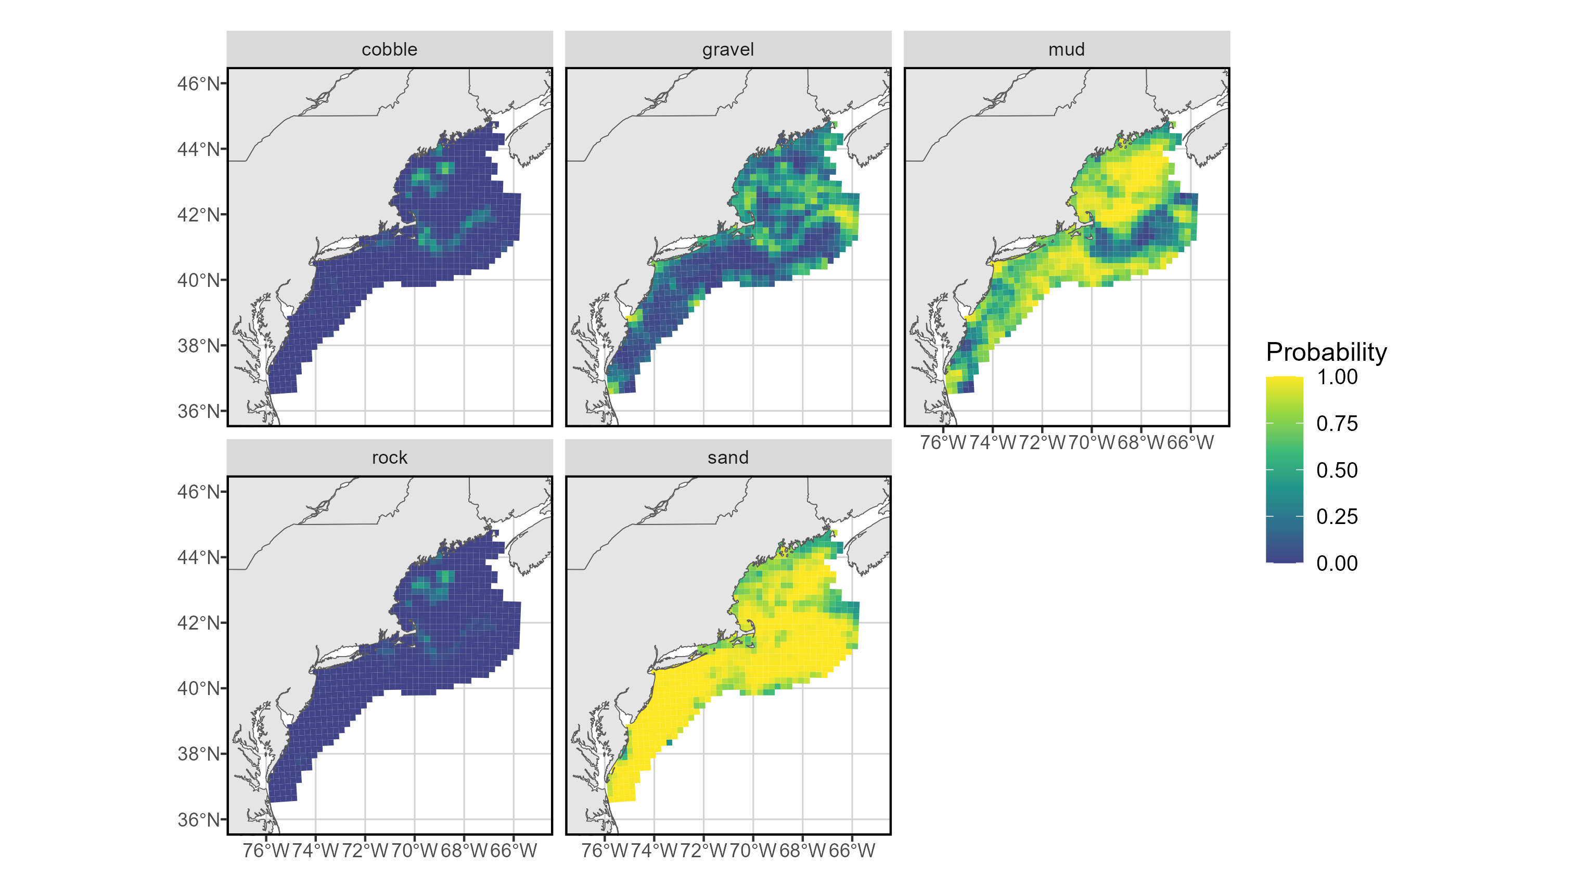
Density covariates – sediment
Notes:
Based on work by New England Fishery Management Council
US Seabed, other sediment grabs, scallop fishery-collected bottom video
Model of sediment probability provided by Brad Harris and Felipe Restrepo of Alaska Pacific University

